Slide 1
Covered Bond Treatment according to EU law, related challenges and future perspectives
Wolfgang Kälberer
Head of European Affairs
Association of German Pfandbrief Banks, Brussels
Polish Mortgage Foundation CB Workshop
Warsaw, 06.03.2014

Slide 2
Treatment of Covered Bonds
          under CRR
          under Solvency II
          Liquidity Coverage Ratio
Single Supervisory Mechanism
    special Covered Bond supervision (UCITS 52.4)
Bank Recovery and Resolution Directive
    Bail in & MREL
  Single Resolution Mechanism
  ECB Collateral Framework
  Asset Encumbrance
  Harmonisation of European Covered Bond regimes

Slide 3
Covered Bond treatment under CRR
Standardised Approach: Art. 129 CRR
    Art. 52.4 UCITS + asset quality criteria + LTV limits + valuation requirements
            Commercial property: 60% LTV limit
            Residential property: 80% LTV limit
            Property valuation
              valuation rules of Art. 208 & 229 CRR apply
              CRR offers market value & mortgage lending value options
    Risk weight assigned to CBs and not to the issuing institution +1 step any more (as previously under CRD I to III)
            AAA to AA- (credit quality step 1) = 10% risk weight
            A+ to A- (credit quality step 2) = 20% risk weight
            BBB+ to BBB- (credit quality step 3) = 20% risk weight
            BB+ to BB- (credit quality step 4) = 50% risk weight

Slide 4
          Transparency requirements: bi-annual reporting of portfolio information (Art. 129 par. 7 CRR)
            value of the cover pool and outstanding CBs
            geographical distribution & type of cover assets, loan size, interest rate and currency risk
            maturity structure of cover assets & CBs
            percentage of more than 90 days past due loans
2. Internal Rating based Approach: Art. 161 par. 1 (d) CRR
          Assignment of an LGD value of 11,25%

Slide 5
Liquidity Coverage Ratio
The Commission shall adopt by 30 June 2014 a delegated act specifying assets of extremely high credit quality and liquidity (Level 1 assets) vs. assets of high credit quality and liquidity (Level 2 assets) on the basis of a report produced by EBA (Art. 460 & 509 (3) CRR)
EBA published its report on 20 December 2013 recommending that extremely HQLA assets should be:
    EEA sovereign bonds issued in domestic currency, rated ECAI 1, with a minimum issue size of EUR 250 million (or the local currency equivalent).
    EEA covered bonds rated ECAI 1 with a minimum issue size of EUR 500 million (or the local currency equivalent) and subject to additional conditions relating to the regulations governing the covered bond structure
    Quote from EBA report p. 36: “Overall, government bonds and covered bonds obtain a similar ranking. Government bonds generally perform better than covered bonds on volume and trading frequency measures, while covered bonds perform better on measures related to the volatility of prices and bid/ask spreads”

Slide 6
Liquidity Coverage Ratio
EBA concluded on the basis of a qualitative judgment and the importance to align the EU legislative framework with Basel III that only EEA sovereign bonds shall be recognised as extremely HQLA
The Commission currently assesses the appropriateness of EBA’s recommendation taking into account:
    Recital 100 of the CRR: at least government bonds and covered bonds traded on transparent markets with an ongoing turnover would be expected to be considered assets of extremely HQLA
    the resilience and tradability of CBs during the crisis
    the high level of security of CBs based on strict legal frameworks
    the need to diversify Level 1 assets in order to reduce the dependence of banks from Member States’ support mechanism
    the recognition of CBs as a traditional European funding instrument

Slide 7
  Covered Bond Treatment under Solvency II: preferential treatment in the market risk module (draft technical standards)
Spread risk sub-module:
AAA to AA- & Maturity of | Spread Risk Factor CBs | Spread Risk Factor Bonds & Loans
5 Years | 0,7% | 0,9%
5 – 10 Years | 0,9% | 1,1%
10 – 15 Years | 0,9% | 7,2%
15 to 20 Years | 0,9% | 9,7%
> 20 Years | 0,9% | 12,2%
A+ to A- & Maturity of | Spread Risk Factor CBs | Spread Risk Factor Bonds & Loans
5 Years | 0,9% | 1,1%
5 – 10 Years | 4,5% | 5,5%
10 – 15 Years | 4,5% | 8,4%
15 to 20 Years | 4,5% | 10,9%
> 20 Years | 4,5% | 13,4%

Slide 8
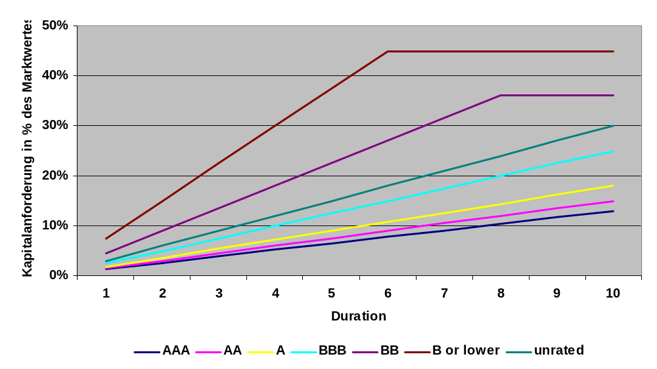
Concentration risk sub-module
Credit quality step of single name exposure | AAA to AA- | A+ to A- | BBB+ to BBB- | BB+ to BB-
Relative excess exposure threshold | 3 % | 3 % | 3 % | 1,5%
Threshold for CBs | 15% | 15% | 15% | 15%
Approx. CB risk weights under Solvency II:
Source: German Insurance Association GDV

Slide 9
Single Supervisory Mechanism SSM
Council Regulation N°1024/2013 of 15 October 2013 (OJ L 287 of 2013) introduced a single supervisory mechanism under the head of the ECB
Credit institutions with a total asset value exceeding 30 billion Euro will be directly supervised by the ECB (significant institutions)
A draft SSM Framework Regulation defining all the rules and procedures governing the cooperation between the ECB and the national authorities is currently under consultation
Covered Bond supervision is not listed by Article 4 of Regulation 1024/2013 defining the tasks conferred to the ECB
    Special public supervision is a key element of European CB regulation (see also UCITS 52.4)
    ECB is not expected to set up a specific Covered Bond unit
    As Covered Bonds are national products, national supervisory authorities are supposed to remain in charge of CB supervision, but
    how will the cooperation between ECB and NCAs regarding CB supervision be organised in order to avoid conflict of competences, e.g. when the significant institution is a CB issuer, when the significant institution is a commercial bank with a specialised daughter company issuing CBs, or when the CB issuer is a less significant institution under the supervision of the NCA ?

Slide 10
Single Supervisory Mechanism SSM: open questions
Who will grant the banking licence for a specialised CB issuing institution?
If national Covered Bond law requires a special Covered Bond licence, will this be granted by the national supervision authority or the ECB?
Is this special Covered Bond licence regarded as being an independent (secondary) licence or only a special add-on to the general banking licence, which will be granted (and withdrawn) by ECB?
What happens in an insolvency procedure over the issuing institution and the non-acceleration of the cover pool? Who decides on the withdrawal of the banking licence and the survival of the cover pool?
Will national supervision authority remain competent to appoint and supervise cover pool monitors?
If national law regulates cover pool inspections, will national supervision authority remain competent to arrange this and draw consequences out of it?

Slide 11
Bank Recovery and Resolution Directive BRRD
Bail-in
    The principle: Covered Bonds (& cover pool derivatives) are exempt from the bail-in instrument (Art. 38 par. 2 (b))
            Covered Bonds mean instruments as referred to in Article 52(4) of UCITS Directive 2009/65/EC (Art. 2 par. 83 b);
    The exception: resolution authorities are not prevented, where appropriate, to (partially) bail-in Covered Bonds when the value of cover assets does not cover the amount of outstanding Covered Bonds (the liability exceeds the value of the assets or collateral against which it is secured).
    Open questions:
            Wouldn’t such a situation trigger the bankruptcy of the cover pool?
            Under national Covered Bond frameworks, bankruptcy triggers specific proceedings and the application of specific tools (e.g. transfer of cover pool and Covered Bonds to another issuer): is there a legal conflict between national law and BRRD? Who will make the final decision ? Is a consent of the – so far national – supervisory authority necessary?

Slide 12
    Open questions:
          Is the issuing institution wound-up? Who will make the decision to start an official insolvency procedure over a Covered Bond issuer and who will file the application to court?
          How will the value gap be calculated? Who will carry out this calculation? Who will decide on the results of the calculation?
          Who will select the cover pool administrator (regulated in many Covered Bond frameworks) and who will supervise him, the competent body on the national level or on the European level?
        2. Minimum requirements for eligible liabilities (MREL)
          It is up to the national resolution authority to determine for each institution the applicable MREL on the basis of criteria provided by Art. 39 par. 3 BRRD
          Art. 39 par. 1a BRRD provides an exemption from MREL for mortgage credit institutions financed by Covered Bonds and not allowed to receive deposits
          The requirement that access to the resolution fund is subject to prior shareholders’ and creditors’ contribution to loss absorption and recapitalisation of 8% of total liabilities and own funds translates into a 8% MREL ratio
            this could represent a challenge for specialised Covered Bond issuers

Slide 13
Single Resolution Mechanism (SRM)
Sets up a Single Resolution Board (central decision-making body) and a Single Resolution Fund
Consensus between EP and Council still pending, trilogue negociations focus on:
              the scope of SRM (all banks vs. SSM banks)
              decision making mechanism (competent body)
                who initiates the resolution of a bank?
                does this decision extend to the treatment of over-collateralisation (asset encumbrance)?
              Financing arrangements of the single resolution fund (target level, national compartments, timing)
            Consistency of SRM provisions with BRRD provisions required with respect to:
              Covered Bond definition (no explicit definition, Art. 10 MREL and Art. 24 scope of bail-in refer to UCITS 52.4)
              Exclusion from bail-in (Art 24 on scope of the bail-in tool excludes Covered Bonds and Member States may exempt Covered Bonds from partial bail-in)
              MREL

Slide 14
Need to harmonise CB definitions / treatment in all EU legal provisions
European Banking Union
S R M
Single Resolution Mechanism
- Regulation -
BRRD
Bank Recovery and Resolution Directive
Tool box
• bail-in •valuation • MREL
Treatment of Covered Bonds
UCITS vs. CRR
exclusion from bail-in
nat. discretion for partial write-down, if lack of coverage (=2nd bail-in)
special supervision
SSM
Single Supervisory Mechanism
- Regulation -

Slide 15
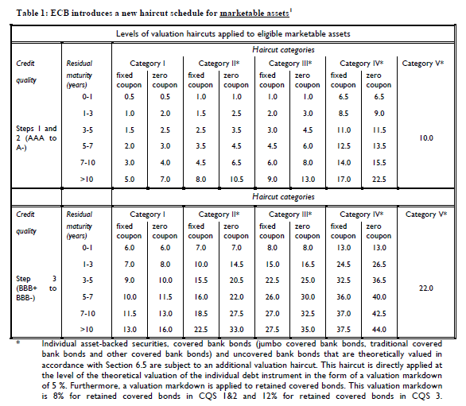
ECB Collateral Framework: Treatment of Covered Bonds since 2013
Jumbo Covered Bonds
Covered Bonds
Source: ECB

Slide 16
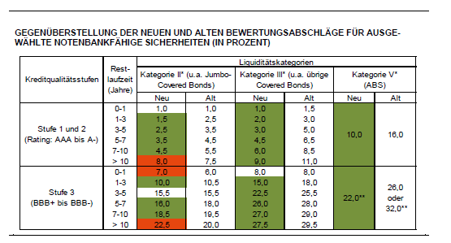
ECB Haircut Schedule for Covered Bonds:
Source: DZ Bank
1. Common valuation haircut: see table above
2. Additional markdown for theoretical valuation (no market rates): 5%
3. Additional markdown for retained Covered Bonds: 8% for Step 1&2 and 12% for Step 3

Slide 17
Asset Encumbrance
European legislator, ECB and EBA focus on asset encumbrance in order to protect the unsecured creditors of the credit institution
Art. 503 par. 2(c) CRR stipulates that EBA shall assess in its Covered Bond review “the extent to which Covered Bond issuance by a credit institution impacts on the credit risk to which other creditors of the issuing institution are exposed”
ESRB Recommendations on Funding of Credit Institutions of December 2012 on the management, monitoring & transparency of asset encumbrance
Main asset encumbrance drivers are:
Central bank funding
Repos
Derivatives
Covered bonds (including legal & voluntary over-collateralisation)
  Evidence shows:
Covered Bonds are not main drivers of AE
CB related AE = transparent, because volumes of CBs and cover pools are regularly published
No EU-law limit for CB volumes, a few countries set national limits (see next chart)

Slide 18
National regulations on asset encumbrance regarding covered bonds:
Country | Limit on covered bond issuance
Australia | 8% of total Australian assets
Belgium | Maximum amount is capped at 8% of issuer total assets
Canada | 4% of total assets
Greece | 20% of total unencumbered assets
Italy | Issuance limited to a percentage of eligible cover assets. Limits are based on capitalisation of the institution however (no limit if tier 1 >11% + tier 2 > 7%)
Netherlands | Ratio between covered bonds to total assets has to be "healthy", DNB decides on a case by case basis
New Zealand | 10% issuance limit on the proportion of a New Zealand bank’s assets that may be encumbered in favour of covered bonds
US | According to the FDIC's Covered Bond Policy Statement and the US Treasury's Best Practice Guide: 4% of total liabilities

Slide 19
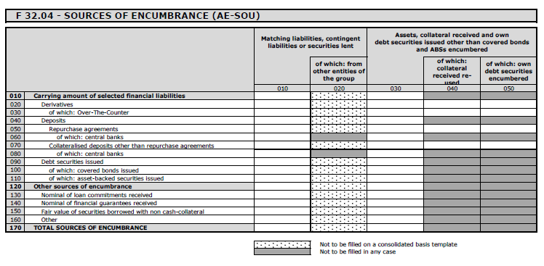
EBA ITS on asset encumbrance reporting

Slide 20
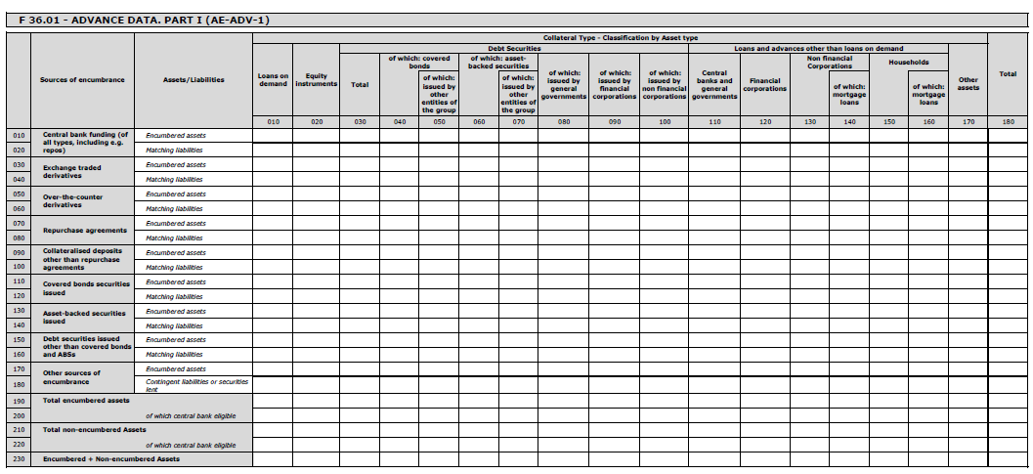
EBA ITS on asset encumbrance reporting

Slide 21
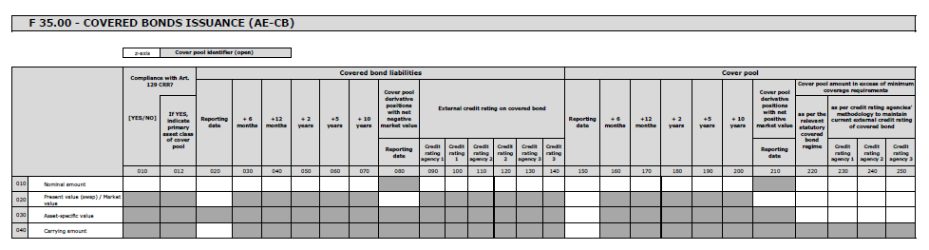
EBA ITS on asset encumbrance reporting

Slide 22
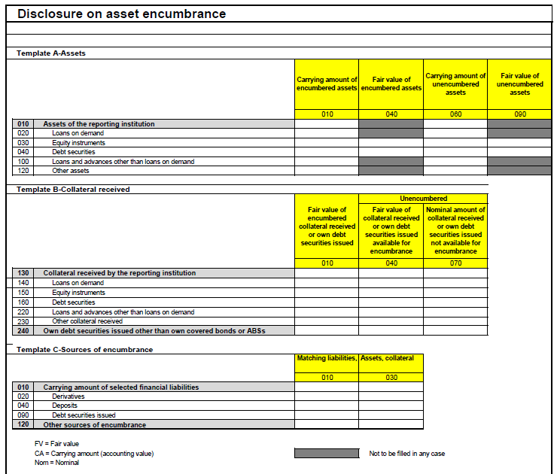
EBA draft ITS on asset encumbrance disclosure

Slide 23
Harmonisation of Covered Bond Frameworks
ESRB recommendation ‚E‘ on funding of credit institutions of 20 December 2012 requests
    national supervisory authorities to identify best practices regarding covered bonds and to encourage harmonisation of their national frameworks
    EBA to deliver by 31 December 2015 a report to the ESRB and to the Council containing an assessment of the functioning of the framework for covered bonds under the best practice principles and its view on recommended further action if deemed desirable
Green Paper on Long Term Financing of the European Economy of 25 March 2013 raised the question about
    “the pros and cons of developing a more harmonised framework for covered bonds? What elements could compose this framework?”
COM Communication on Long-Term Financing of the European Community due to be published on 12 March 2014 stipulates that the Commission
    will undertake by mid-2015 an impact assessment on the merits of introducing an EU framework for covered bonds based on the findings of the review of the covered bond treatment in the CRR

Slide 24
Harmonisation of Covered Bond Frameworks
  EBA is currently conducting a Covered Bond review in accordance with Art. 503 CRR in order to assess if the risk weights for CBs laid down in Article 129 CRR are adequate and weather the criteria are appropriate
    This review considers credit quality, eligible collateral, transparency, strengthened supervision, enforceability of preferential rights and bankruptcy segregation aspects
In order to protect covered bonds from future harmful developments and to strengthen the solidity of the product, a prudent and tailor-made harmonization (minimum harmonisation) of a certain number of principles could be discussed, e.g.
    eligible asset classes
    special public supervision
    valuation
    transparency and
    bankruptcy remoteness.

Slide 25
Verband deutscher Pfandbriefbanken e.V.
Association of German Pfandbrief Banks
Brussels Office
      Wolfgang Kälberer
Avenue Michel Ange 13
1000 Brussels
Phone +32 2 7324638
Fax +32 2 7324802
E-Mail: kaelberer@pfandbrief.de
Internet: http://www.pfandbrief.de / http://www.pfandbrief.org

